Slide 1
Azure Discovery
March 14, 2015

Slide 2
Deploy Azure cloud service with command line
NAnt, PowerShell
Theeranit Pongtongmuang (Amm) MCT, MCPD VP of Engineering Noonswoon

Slide 3
Demo the project
Project Architecture
How to create Azure cloud project
Important class and file in Azure cloud project
Deploy Azure with Visual Studio
Deploying Azure cloud service with command line
Agenda

Slide 4
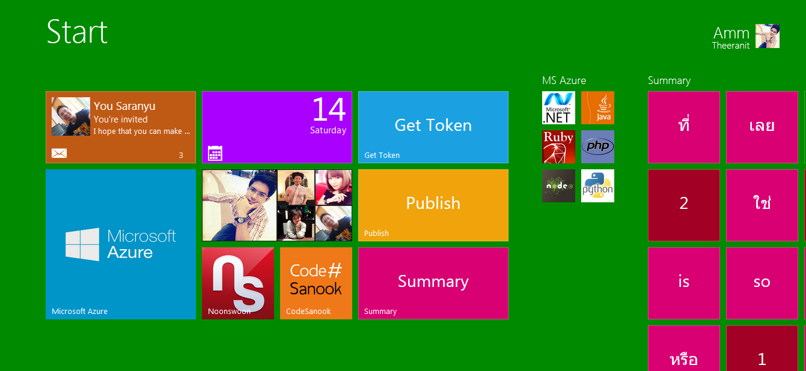
Our Finishing Project ( FB Page Feedback)

Slide 5
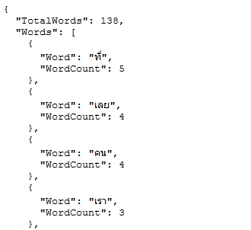
Words split return

Slide 6

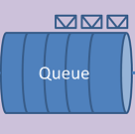
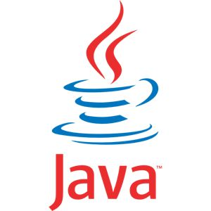

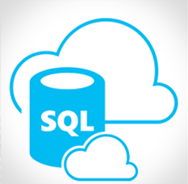
Architecture
Facebook
Graph API
Public FB
Page data
WebRole
WorkerRole
WebSite
Azure environment

Slide 7
Focus on your App not infrastructure

Slide 8
What if without Azure cloud service
Create web project
Create windows service, or exe , console app command line app for query FB data and called split API
Set up Virtual Machine (Linux or Windows)
Deploy web project
Deploy background app project
Setup message queue server (Ex RabbitMQ, ActiveMQ)
Setup Database Server (MS SQL Server, MySQL)

Slide 9
Main benefit from cloud
Managed system, don’t need to maintain server
Focus on your app and a little knowledge on deployment
Build complex application, log running task process
Multitier application ( web role, worker role)
Access unmanaged code( C, C++)
Install any custom MSI
Run exe
Remote desktop access to servers

Slide 10
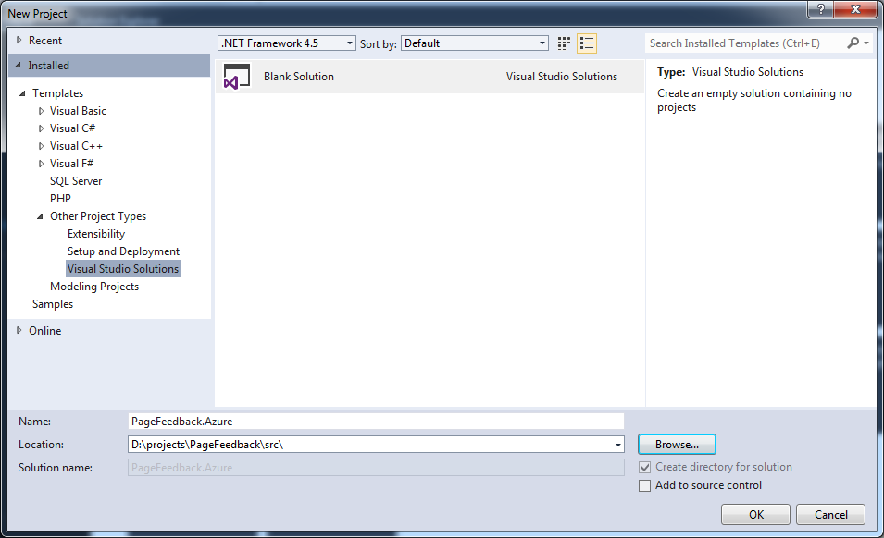
Setup project

Slide 11
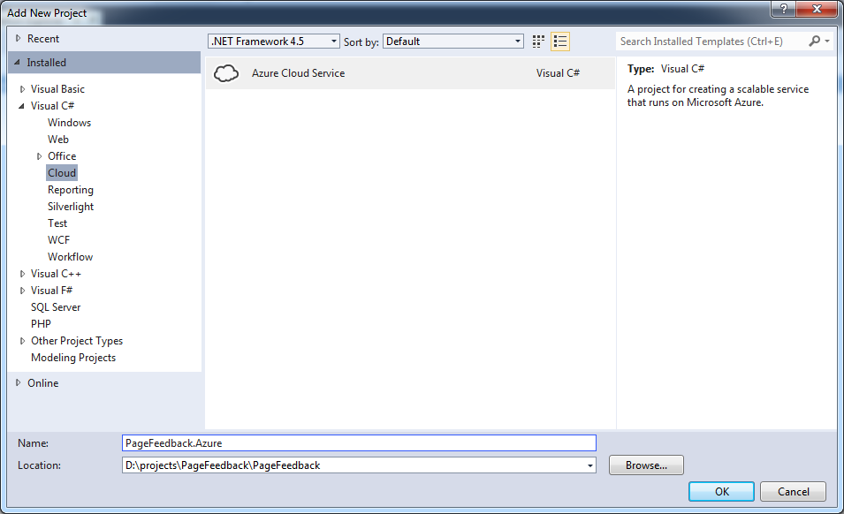
Setup project

Slide 12
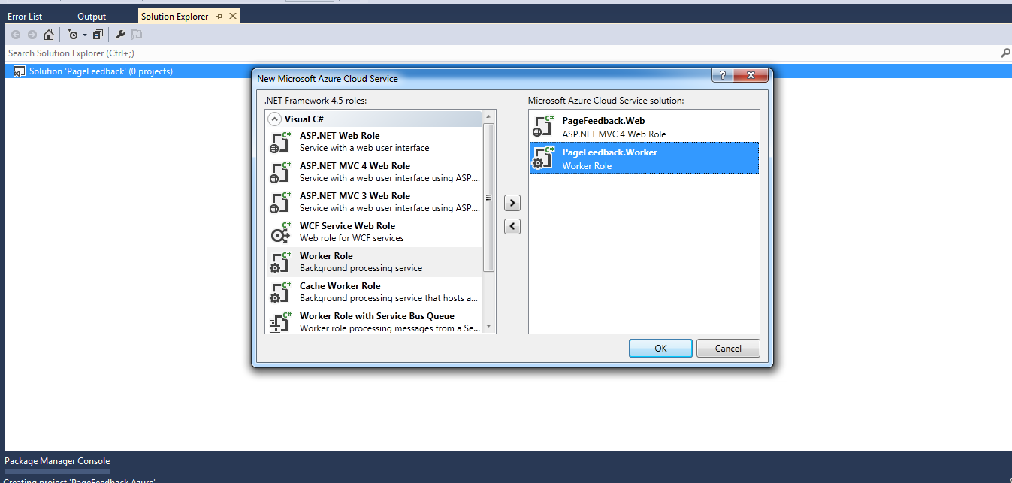
Setup project

Slide 13
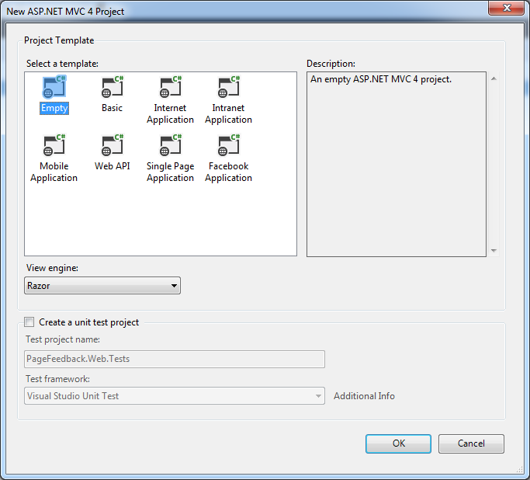
Setup project

Slide 14
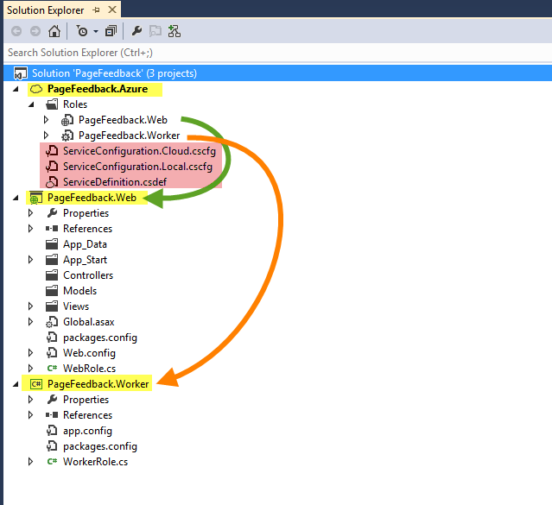
Project structure
Azure cloud service project (PageFeedback.Azure)
Web role project (PageFeedback.Web) => website (usually one per cloud service)
Worker role project (PageFeedback.Worker) => background worker (multiple)

Slide 15
Azure cloud service project (PageFeedback.Azure)
Manage all associated worker roles in solution
Startup project for Azure cloud service project
Container for multiple web roles and worker roles
Contains cloud service configuration file (share to all roles)
ServiceDefinition.csdef (define all configurations)
ServiceConfiguration.Cloud.cscfg ( set configuration values for release environment)
ServiceConfiguration.Local.cscfg (set configuration values for local development)

Slide 16
Web Role Project
Can be any ASP.NET web project (ASP.NET MVC or WebForm)
Only reference with Azure SDK library
Contain base class of RoleEntryPoint (WebRole.cs) as entry point of WebRole, work as controller of machine that web role stay on
Main purpose for web application, request, response, WEB API

Slide 17
Worker Role Project
Just .NET class library project
Only reference with Azure SDK library
Contain base class of RoleEntryPoint (WorkerRole.cs) as entry point of WorkerRole, work as controller of machine that worker role stay on

Slide 18
RoleEntryPoint.cs
3 main method to override
OnStart
Initialize application
Must return true
Run
Working code, in while loop
if it return role will be stop and restart
OnStop
Called when role stop, clear running process, stop consuming message from queue

Slide 19
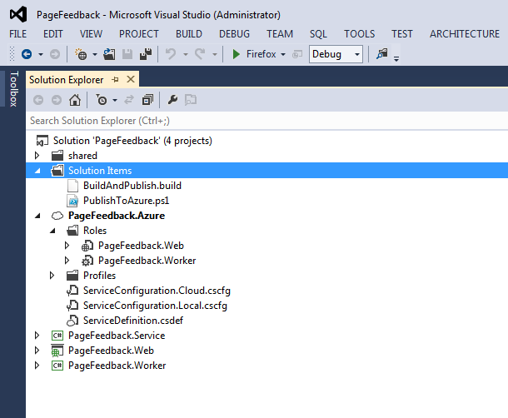
.NET Azure Cloud Service Project

Slide 20
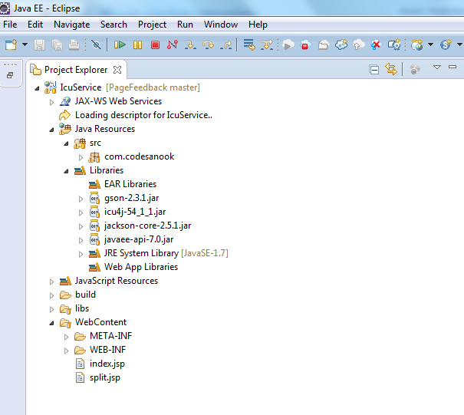
Java REST API Service

Slide 21
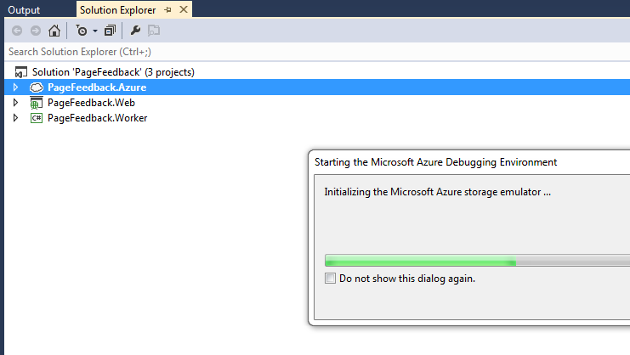
Run Azure cloud project
in Emulator
DEMO

Slide 22
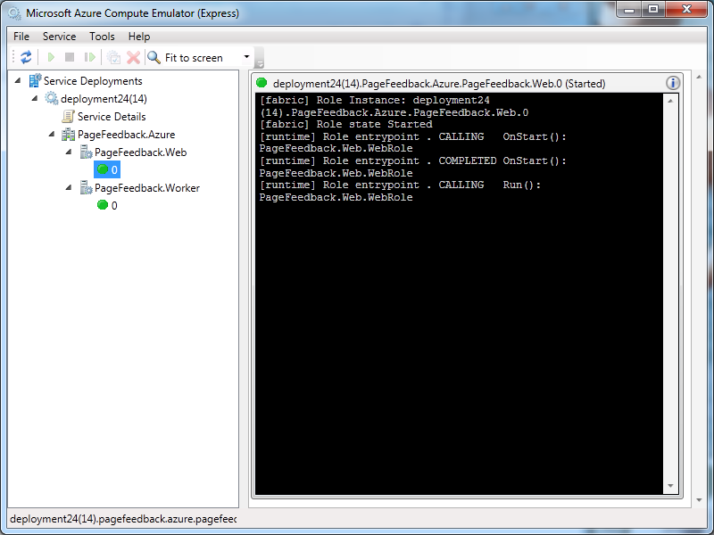
Emulator monitor

Slide 23
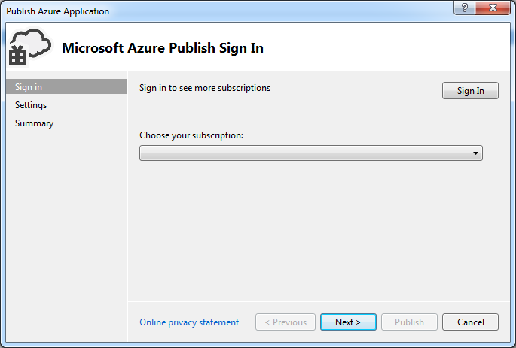
Deploy with Visual Studio

Slide 24
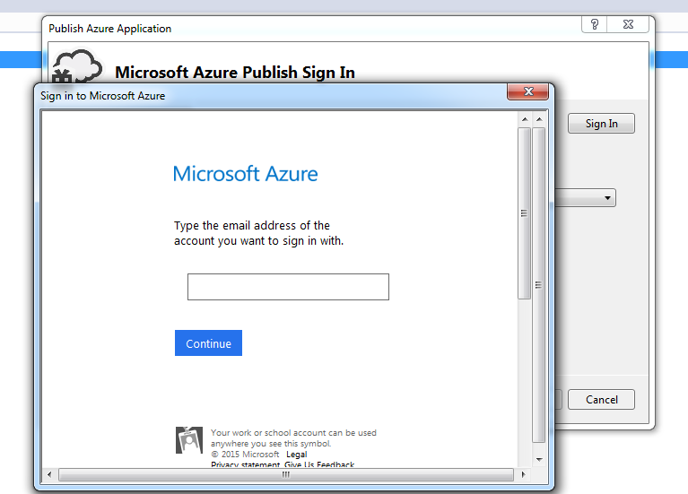
Log In with Azure Account

Slide 25
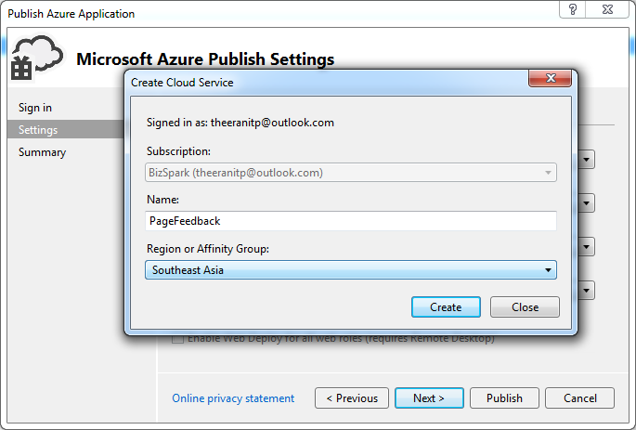
Configure cloud service

Slide 26
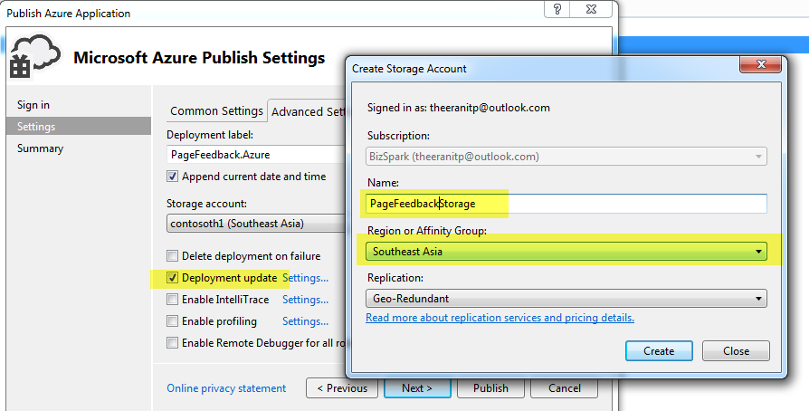
Configure cloud service continous

Slide 27
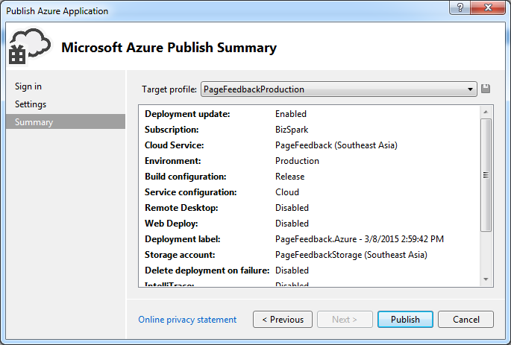
Publish

Slide 28
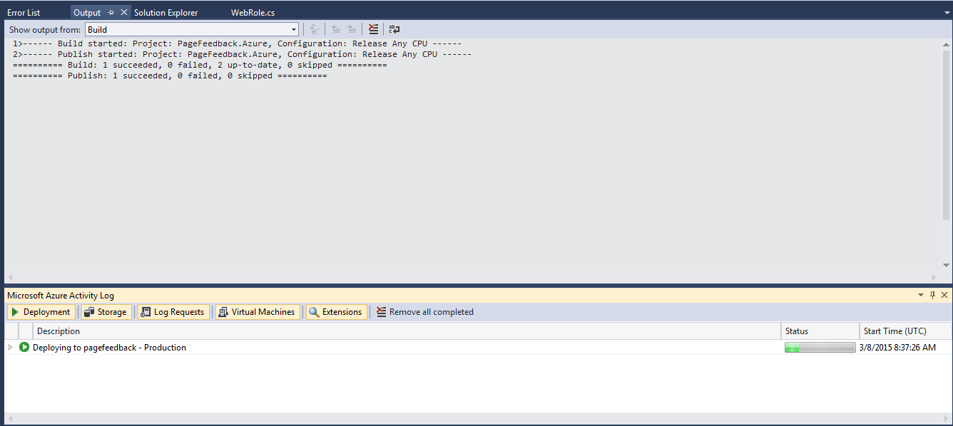
Deploying to Azure

Slide 29
Deploy Azure with Command Line Tool
Benefit
Integrated with build server (Jenkins , Cruise control)
Fast to deploy with Git ( git push origin master)

Slide 30
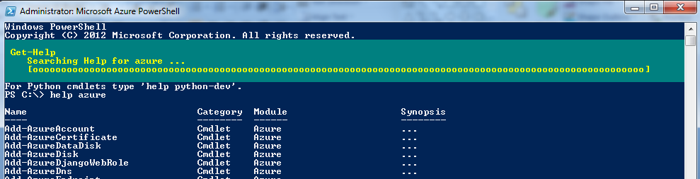
Deploy Azure with Command Line Tool
File to setup Azure PowerShell
Windows6.1-KB2506143-x64.msu (Windows update)
azure-powershell.0.8.10.1.msi

Slide 31
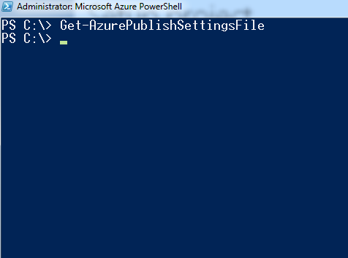
Setup project
> Get-AzurePublishSettingsFile
> Set-ExecutionPolicy Unrestricted -Force

Slide 32
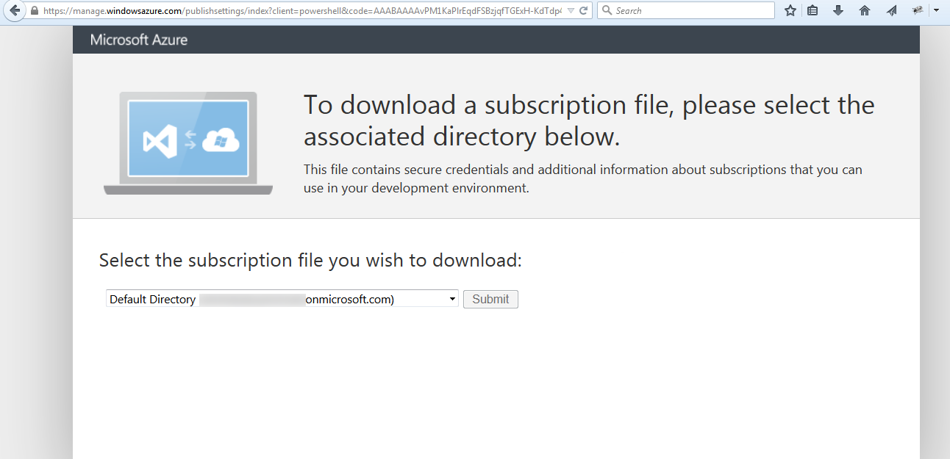
Install Azure PowerShell

Slide 33
NAnt Project
<project>
<target>
<task>
Msbuild
PowerShell command line exe

Slide 34
Scale VM Size and Instance count
Change cloud configuration
Change configuration for Instance size and instance count easily
No need to setup load balancer
Redeploy again

Slide 35

Noonswoon Careers (noonswoonapp.com/careers)

Slide 36
Summary

